Slide 1
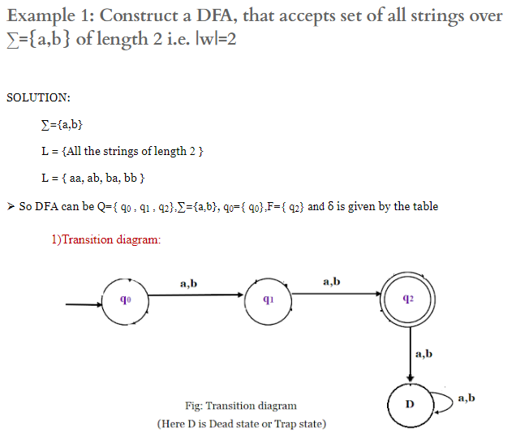
Practice Problems of DFA
1.

Slide 2
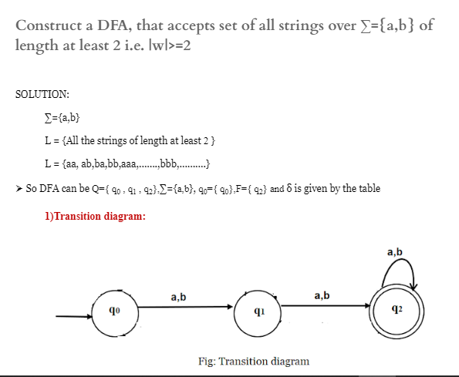
Problem # 2

Slide 3
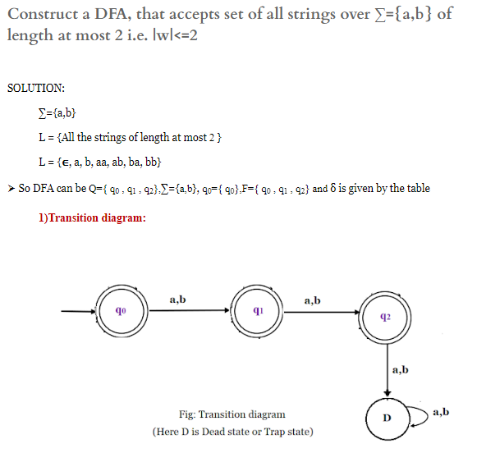
Problem # 3

Slide 4
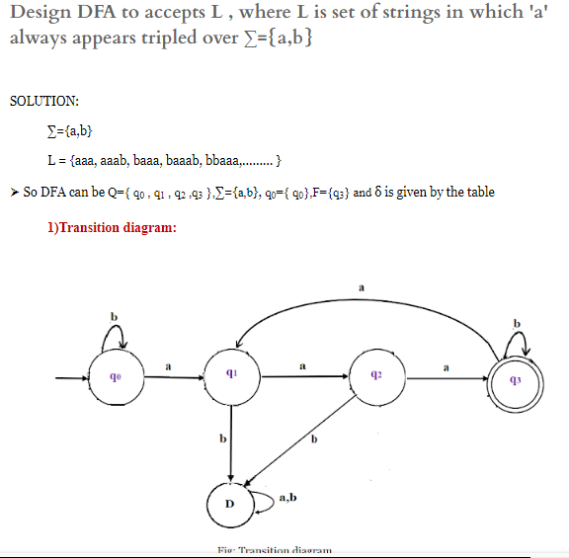
Problem #4

Slide 5
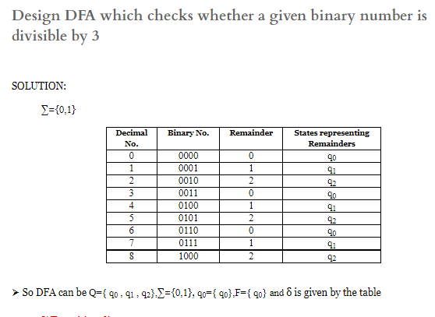
Practical #5

Slide 6
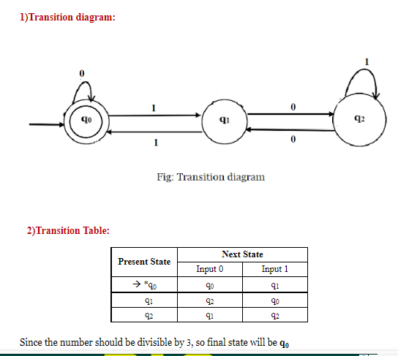
Problem #5

Slide 7
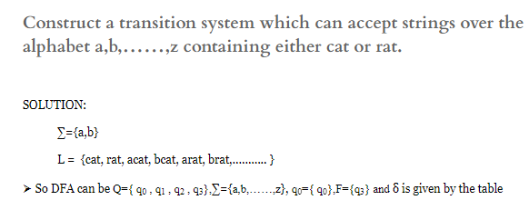
Problem #6

Slide 8
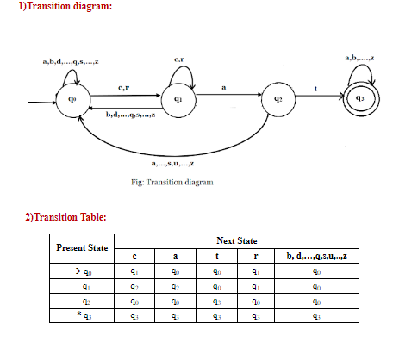
Solution of Problem #6

Slide 9
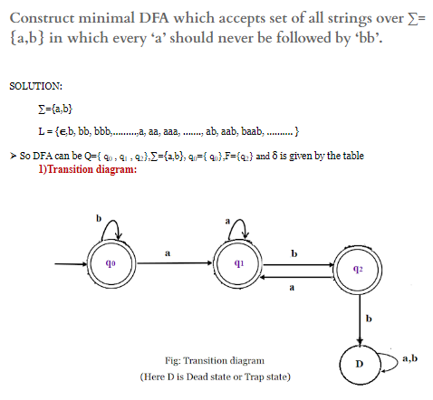
Problem #7

Slide 10
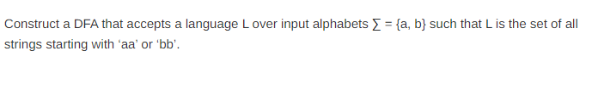
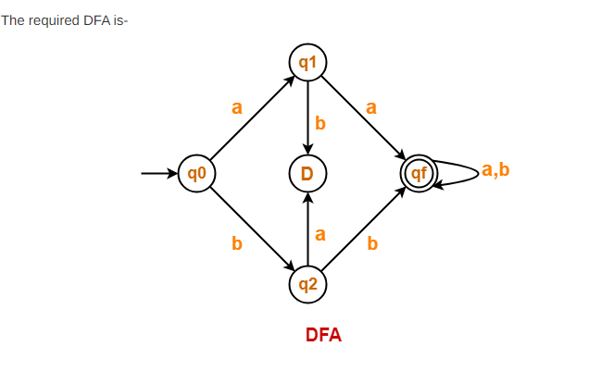
Problem #8

Slide 11
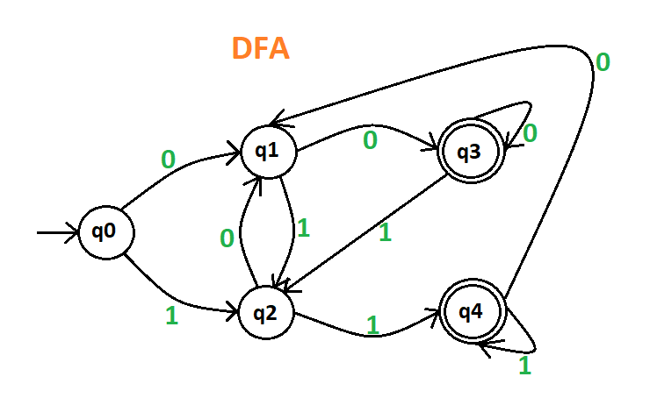
Problem #9
Draw a deterministic and non-deterministic finite automate which accept 00 and 11 at the end of a string containing 0, 1 in it, e.g., 01010100 but not 000111010.

Slide 12
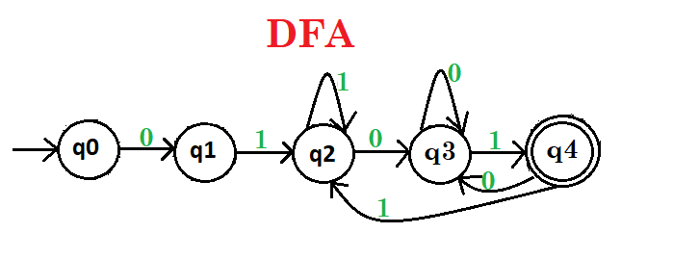
Problem #10
Draw a deterministic finite automate which starts with 01 and ends with 01 of a string containing 0, 1 in it, e.g., 01000101 but not 000111001.

